Slide 1
Table of Contents
Save a filtered Report Slide 2
Share a Bookmark Slide 3
Download Raw data Slide 4
Show Search Feature Slide 5
Links and Sources Slide 6
SCM Weekly Tab Description Slide 7
SCM YTD Tab Description Slide 8
Contact Us Slide 10

Slide 2
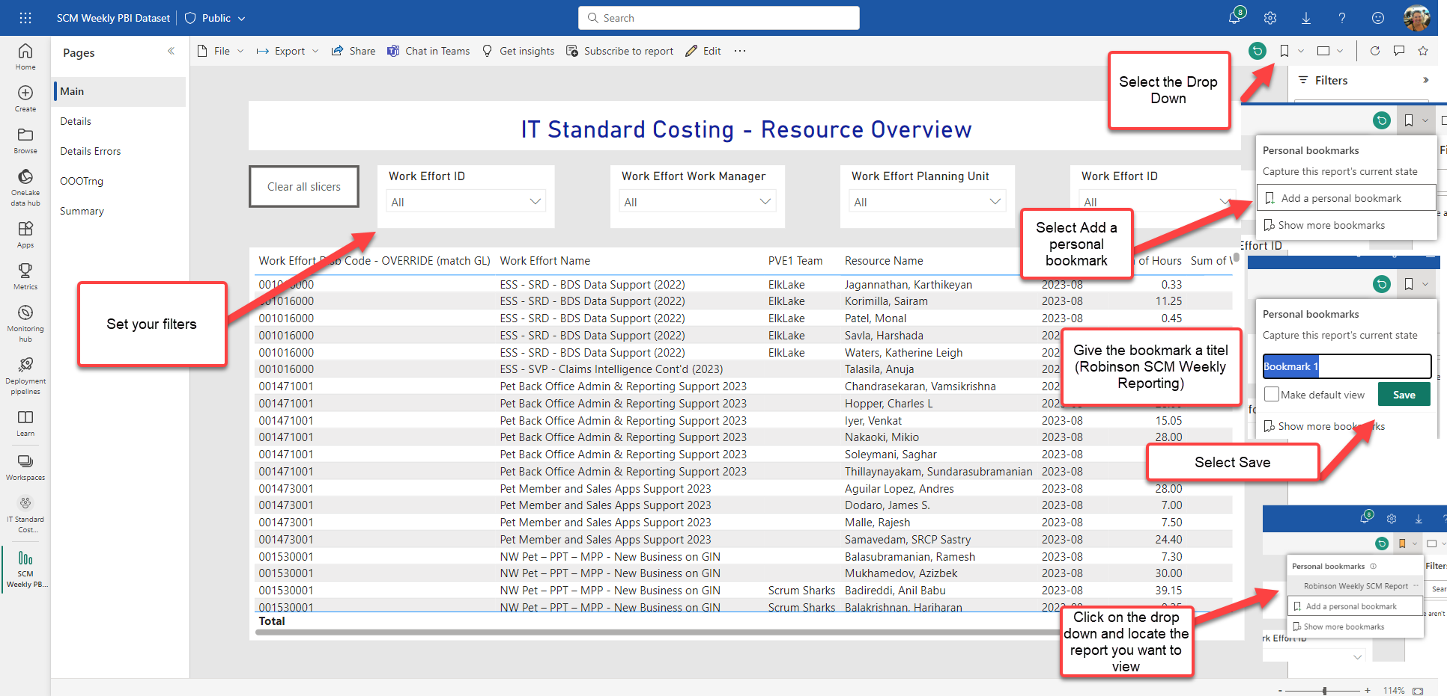
Power BI – Save a filtered View (Report/Visual)
2
3
1
4
5
6

Slide 3
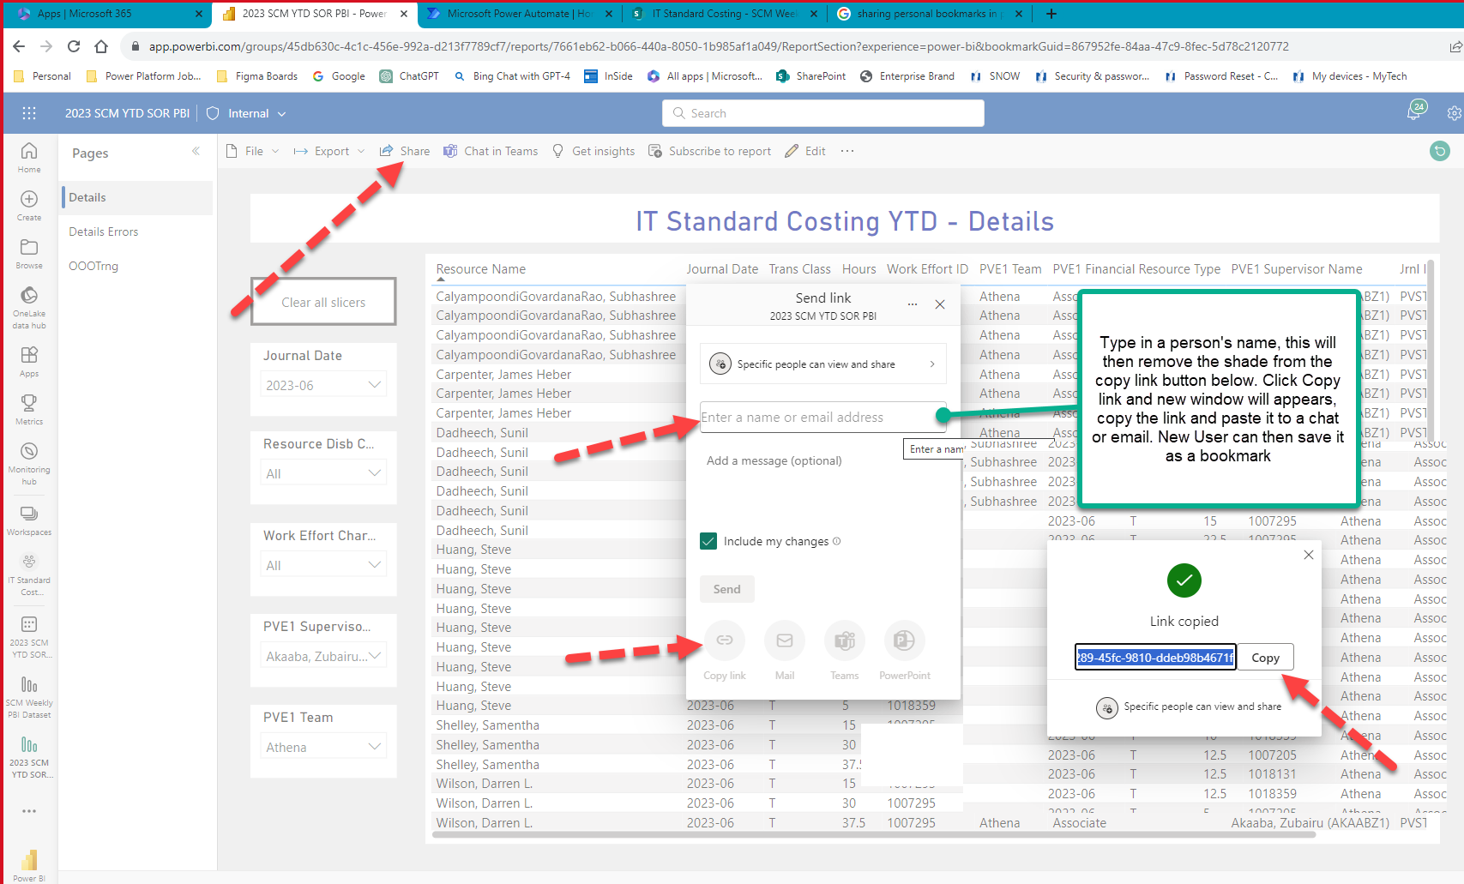
Power BI – Share Bookmark
1
2
3
4

Slide 4
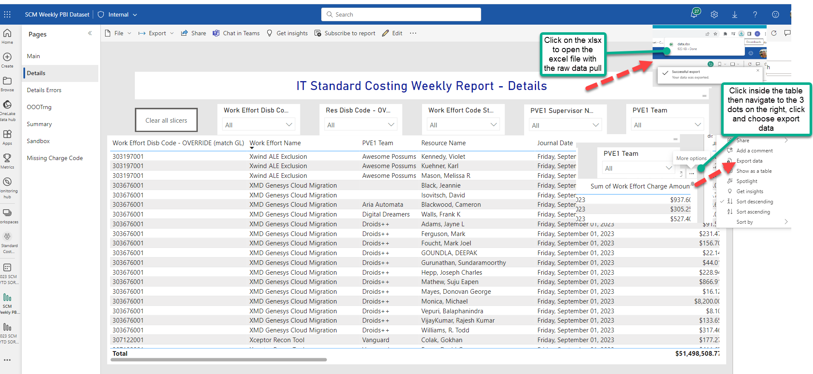
Power BI – Download Raw Data from Report
1
2

Slide 5
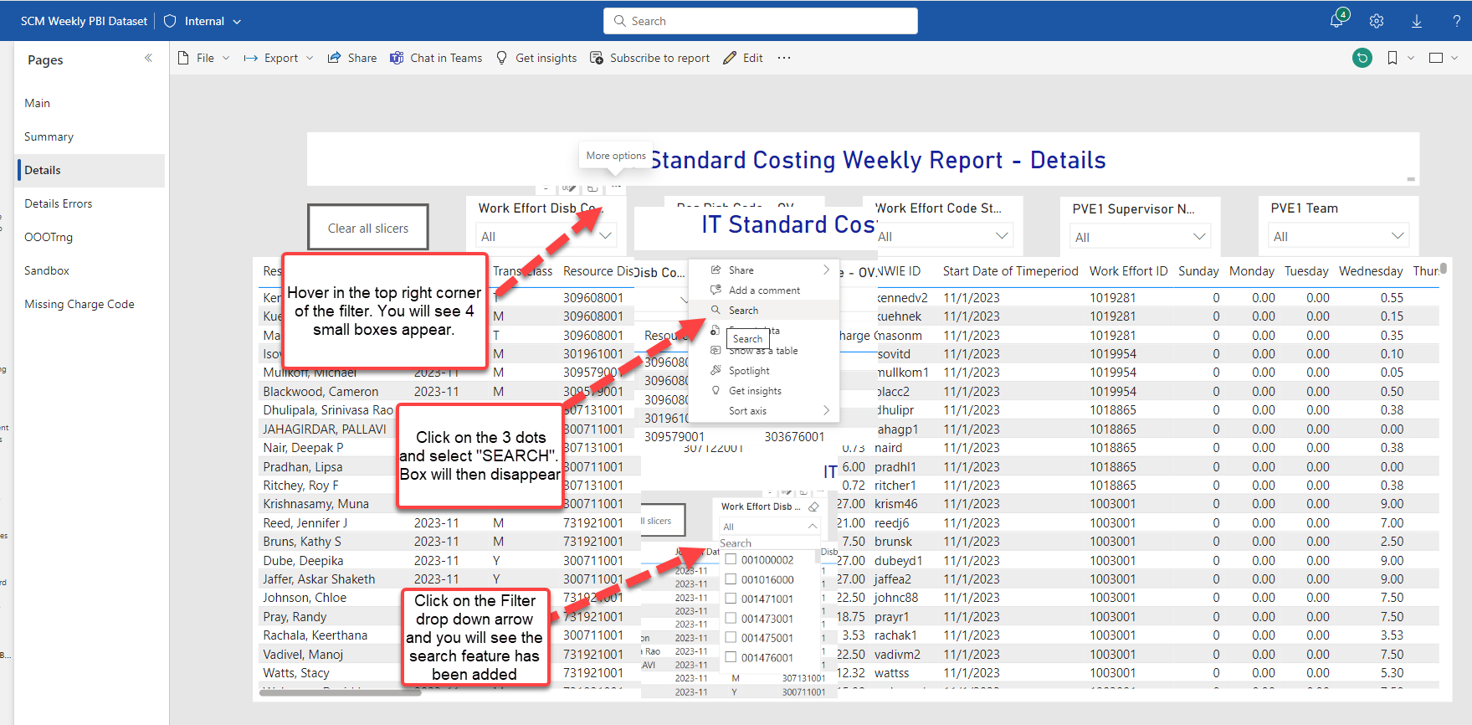
Power BI – Adding Search Feature to Reporting Filters
1
2
3

Slide 6
Link to SCM Power Bi Reports and Sources
SCM Power Bi Links
SCM Power Bi Sources
YTD SCM Report
Weekly SCM Report
Weekly Dashboard
Labor Dashboard
PVE1 (Planview via oData)
SCM Weekly XLS
SCM YTD XLS

Slide 7
SCM Weekly Power Bi Tabs (SCM Weekly XLS)
Main – Pivot that matches the data in the XLS. View by work effort disb code, work effort name and charge amount.
Summary – Summary of the detail data (not broken down by resource). Same view in the xls.
Details – Detailed view by resource each week of data that the resource is actively booking to. Same view in the xls.
Details Errors – Shows where disb code are not aligned to an active strategy. Same view in the xls.
OOOTrng – This shows where resources have booked out of office time and training.
Missing Charge Code – Visual of work effort ID’s that do not have an active disbursement code aligned to it. (oData used to grab associated contacts)

Slide 8
SCM YTD Power BI Tabs (SCM YTD XLS)
Main Pivot – Pivot by work effort disb code and work effort charge amount. Same as XLS.
Details – Detailed view of where resource has booked each week YTD. Same as XLS.
Details Errors – Shows where disb code are not aligned to an active strategy from YTD view. Same view in the xls.
OOOTrng – This shows where resources have booked out of office time and training from YTD view.

Slide 9
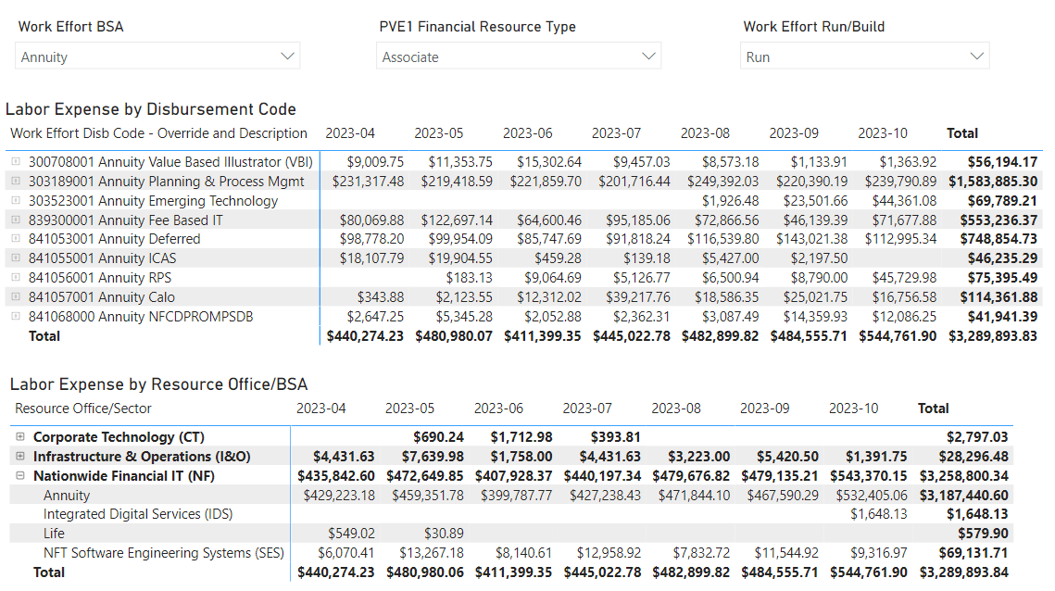
SCM YTD Power BI Tabs (Continued)
Labor Expense – Standard cost labor expense by disbursement code and by resource office/BSA for selected BSA. Filters include financial resource type, run/build and date
Select BSA where labor expense hits.
Select resource type and Run/Build
Total Labor Expense should match financials

Slide 10
SCM YTD Power BI Tabs (Continued)
Labor by Team (1) – Standard cost labor expense by team, including details by disbursement code; Filters include disbursement code, resource type and Run/Build
Labor by Team (2) – Shows which team(s) are charging to a selected disbursement code and work item
  Tip 1: Click on plus sign in bottom table to drill into work items within a disbursement code
  Tip 2: Click on a number in the Total column in the bottom table to see the teams working on that code or work item in the top table

Slide 11
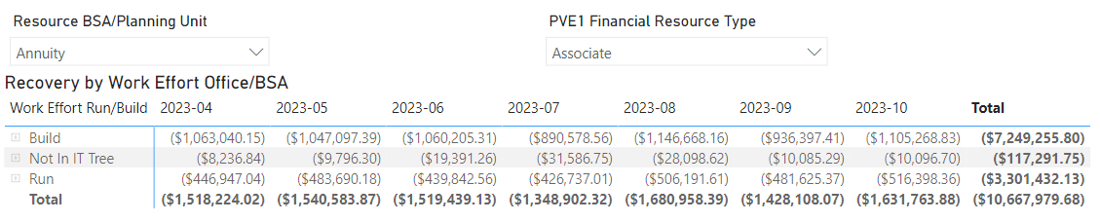
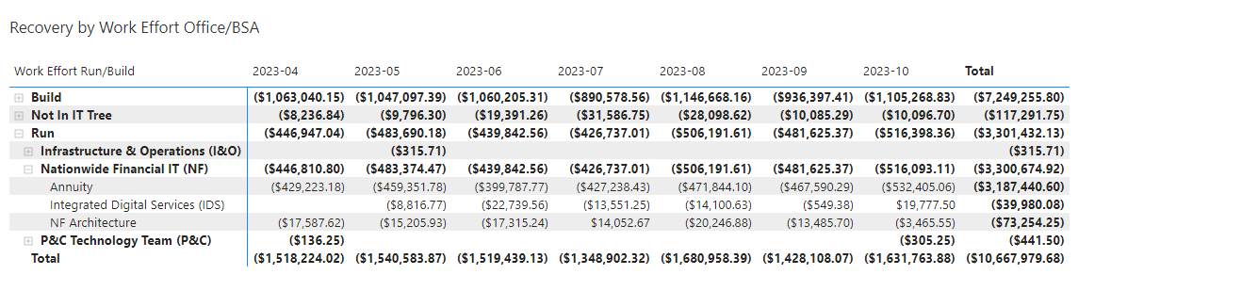
SCM YTD Power BI Tabs (Continued)
Recovery (STD Cost Credit) – Shows where resources for a selected BSA/Planning Unit charged their time, including Run/Build detail
Select BSA where resources sit
Click on plus sign to drill into BSA where resources are charging

Slide 12
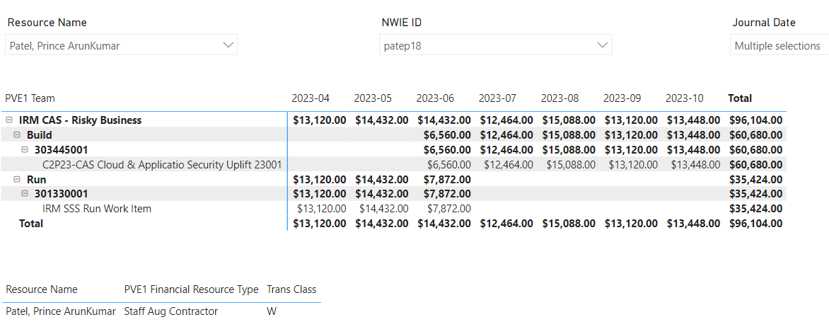
SCM YTD Power BI Tabs (Continued)
Resource – Select a resource by name or NWIE ID to see which team, disbursement code(s) and work items that resource has been working on, as well as resource type and trans class

Slide 13
SCM YTD Power BI Tabs (Continued)
Labor Expense – Standard cost labor expense by disbursement code and by resource office/BSA for selected BSA. Filters include financial resource type, run/build and date
Labor by Team (1) - Standard cost labor expense by team, including details by disbursement code; Filters include disbursement code, resource type and Run/Build
Labor by Team (2) - Shows which team(s) are charging to a selected disbursement code and work item
Recovery (STD Cost Credit) – Shows where resources for a selected BSA/Planning Unit charged their time, including Run/Build detail
Resource – Shows team, disbursement codes charged and work items for a selected resource

Slide 14
Contact Us
Emanuel Fuller
Chris Brown-Grant

